Slide 1


Cloud for AI
Course 4: Introduction to Modelling
Filotas Theodosiou

Slide 2
What are we going to talk about today

Slide 3
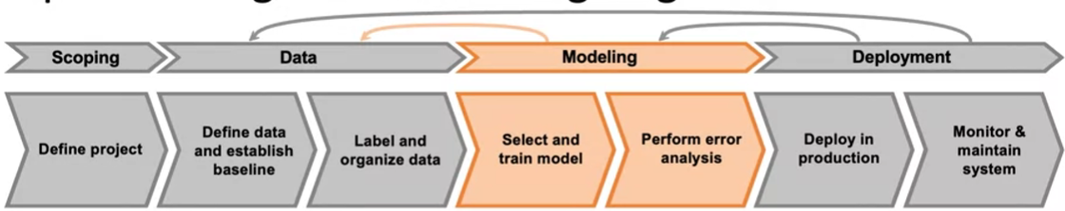
Modeling
Modelling Stage
How to select and train a ML model for an industry application
Notes:
We will talk about this later in more detail

Slide 4
How would you select a model?

Slide 5
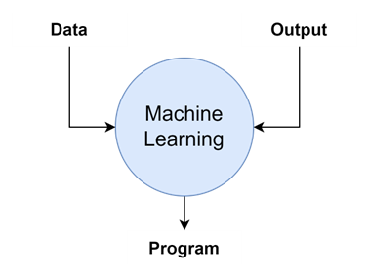
The Core of AI systems
AI system = Code + Data
(algorithm/model)

Slide 6
The Core of AI systems
AI system = Code + Data
(algorithm/model)
Code:
Over the past decades there has been extensive research on improving the code (the models)
Many have tried to find an architecture that works well on all tasks
All have failed! (Next candidate: LLMs)
Many times it is a solved problem (You simply download a model from github etc)

Slide 7
The Core of AI systems
AI system = Code + Data
(algorithm/model)
Code:
Over the past decades there has been extensive research on improving the code (the models)
Many have tried to find an architecture that works well on all tasks
All have failed! (Next candidate: LLMs)
Many times it is a solved problem (You simply download a model from github etc)
Data
It is case specific and is (mainly) the reason why a model works fails on a task
Data is more customized for your problem than the model
Thus, its usually more efficient to improve your data than your model!!

Slide 8
What influences the performance of a Model
Super Attention:
Machine learning is an empirical process
Then, modelling is an iterative process too!!

Slide 9
What influences the performance of a Model
Super Attention:
Machine learning is an empirical process
Then, modelling is an iterative process too!!
Code (algorithm/model)
Hyperparameters
Data
ML Model

Slide 10
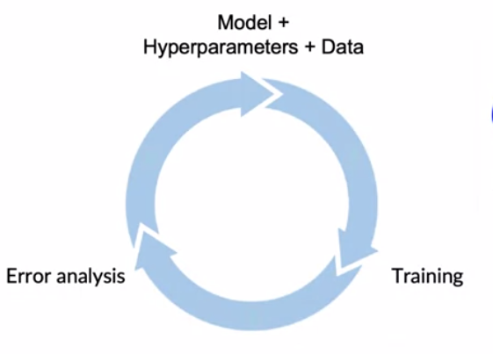
What influences the performance of a Model
Super Attention:
Machine learning is an empirical process
Then, modelling is an iterative process too!!
Code (algorithm/model)
Hyperparameters
Data
ML Model
Modeling loop

Slide 11
What influences the performance of a Model
Super Attention:
Machine learning is an empirical process
Then, modelling is an iterative process too!!
Code (algorithm/model)
Hyperparameters
Data
ML Model
Modeling loop
Tips:
Go through the loop many times quickly is key to improving performance
Time spent on each stage: Data > Code > Hyperparams

Slide 12
Things to consider in model development
Doing well on a training set (measured by average training error)
Verify that the model does not underfit!

Slide 13
Things to consider in model development
Doing well on a training set (measured by average training error)
Verify that the model does not underfit!
Doing well on dev/test set
Verify that the model can generalize on unseen data!

Slide 14
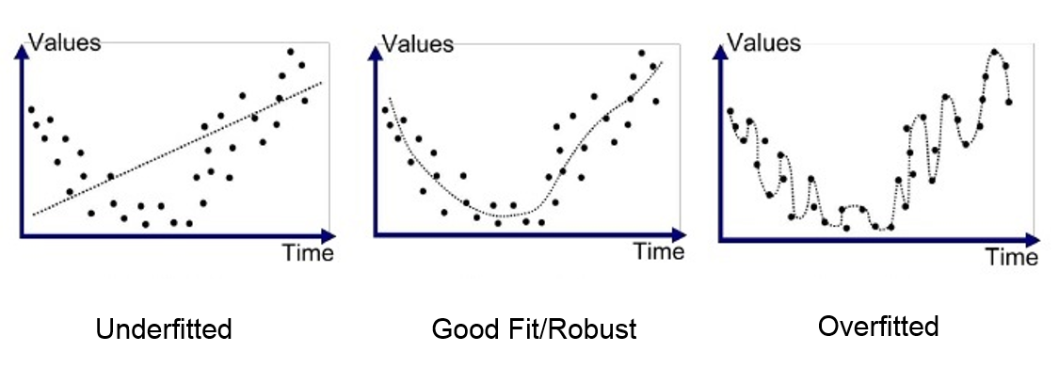
Things to consider in model development
Underfit
Doing well on a training set (measured by average training error)
Verify that the model does not underfit!
Doing well on dev/test set
Verify that the model can generalize on unseen data!

Slide 15
Things to consider in model development
Underfit
Doing well on a training set (measured by average training error)
Verify that the model does not underfit!
Doing well on dev/test set
Verify that the model can generalize on unseen data!
Does not memorize training set!
If there is a big difference in training/test performance the model might have overfitted the training data!

Slide 16
Things to consider in model development
Underfit
Doing well on a training set (measured by average training error)
Verify that the model does not underfit!
Doing well on dev/test set
Verify that the model can generalize on unseen data!
Does not memorize training set!
If there is a big difference in training/test performance the model might have overfitted the training data!
Overfit

Slide 17
Things to consider in model development
Underfit
Doing well on a training set (measured by average training error)
Verify that the model does not underfit!
Doing well on dev/test set
Verify that the model can generalize on unseen data!
Does not memorize training set!
If there is a big difference in training/test performance the model might have overfitted the training data!
Overfit
Just right

Slide 18
Things to consider in model development
Underfit
Doing well on a training set (measured by average training error)
Verify that the model does not underfit!
Doing well on dev/test set
Verify that the model can generalize on unseen data!
Does not memorize training set!
If there is a big difference in training/test performance the model might have overfitted the training data!
Doing well on business metrics/project goals
Even if you have good model performance, you still need to persuade your manager about it!
Overfit
Just right

Slide 19
Why low average test error is not enough?

Slide 20
The non-alignment problem!
In general, a model treats all predictions equally!
The test-set performance is measured from all examples on a test set
In some applications, specific predictions are more important than others!
How will the model know our specific preferences?
Example: Self-driving cars?
One mistake can be costly!

Slide 21
Performance on disproportionately important examples
Web Search Application Example:
User types a Web Search and a model ranks the best results
Informational Queries: “Apple pie recipe”, “Latest movies”, “Wireless data plan”, “Food near me”
Navigational Queries: “VIVES University Address”, “Youtube”, etc

Slide 22
Performance on disproportionately important examples
Web Search Application Example:
User types a Web Search and a model ranks the best results
Informational Queries: “Apple pie recipe”, “Latest movies”, “Wireless data plan”, “Food near me”
Navigational Queries: “VIVES University Address”, “Youtube”, etc
A user will be fine in not getting the absolute best “Apple pie recipe”
A user will not be fine if he does not get the exact VIVES University Address
The model treats all predictions equally!
Takeaway: Sometimes specific errors should be weighted more!!

Slide 23
Performance on key parts of a dataset
Fairness.
A very important topic on AI today.
Example 1: ML for Loan Approval
Make sure not to discriminate by ethnicity, gender, location, language or other protected attributes
Example 2: Product recommendations from retailers
Be careful to treat fairly all major users, retailer, product categories

Slide 24
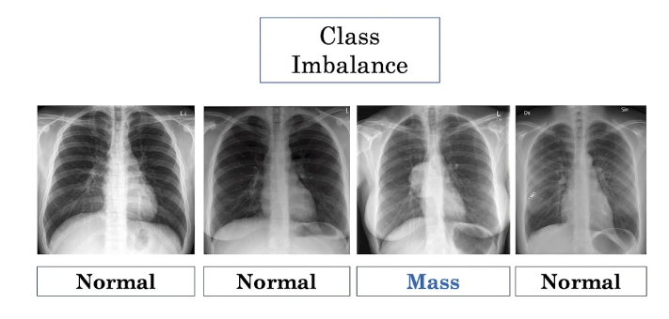
Performance on rare classes
Skewed data distributions!
Medical classification application:
In medical diagnosis, its not uncommon for many patients to NOT have a specific disease

Slide 25
Performance on rare classes
Skewed data distributions!
Medical classification application:
In medical diagnosis, its not uncommon for many patients to NOT have a specific disease
Say we have 99% negatives and 1% positive
Why should I train a model?
Just do print(“0”)
You will achieve 99% accuracy!!

Slide 26
Performance on rare classes
Skewed data distributions!
Medical classification application:
In medical diagnosis, its not uncommon for many patients to NOT have a specific disease
Say we have 99% negatives and 1% positive
Why should I train a model?
Just do print(“0”)
You will achieve 99% accuracy!!
Is 99% accuracy a good thing?
Is the 1% positive more important?

Slide 27


Unfortunate conversation in companies
Machine Learning Engineer: “I did well on the test set”
Product owner: “But it does not work in my application”
Machine Learning Engineer: “But… I did well on the test set”

Slide 28
Unfortunate conversation in companies
Machine Learning Engineer: “I did well on the test set”
Product owner: “But it does not work in my application”
Machine Learning Engineer: “But… I did well on the test set”
Tip!!
Don't get defensive here.
Its great that you build a great ML model
Just make align it to make it useful in the real-world

Slide 29
The importance of Baselines
The most important step before modeling is to build a Baseline!!
Consider the application:
A company gives me daily sales of ice-creams and wants to know how many they will sell tomorrow

Slide 30
The importance of Baselines
The most important step before modeling is to build a Baseline!!
Consider the application:
A company gives me daily sales of ice-creams and wants to know how many they will sell tomorrow
Me 4 years ago!
I spend one week building the most advanced Deep Learning Neural Network
I compare it with the simplest model (a linear regression)
The performance is equal!!!
They are mad!

Slide 31
The importance of Baselines
The most important step before modeling is to build a Baseline!!
Consider the application:
A company gives me daily sales of ice-creams and wants to know how many they will sell tomorrow
Me 4 years ago!
I spend one week building the most advanced Deep Learning Neural Network
I compare it with the simplest model (a linear regression)
The performance is equal!!!
They are mad!
Me now!
I spend one hour building the simplest baseline
It achieves good enough performance for them
I spend 1 more day and improve the performance a bit based on the mistakes of the first model
They are very happy!

Slide 32
The importance of Baselines
The most important step before modeling is to build a Baseline!!
Consider the application:
A company gives me daily sales of ice-creams and wants to know how many they will sell tomorrow
Me 4 years ago!
I spend one week building the most advanced Deep Learning Neural Network
I compare it with the simplest model (a linear regression)
The performance is equal!!!
They are mad!
Me now!
I spend one hour building the simplest baseline
It achieves good enough performance for them
I spend 1 more day and improve the performance a bit based on the mistakes of the first model
They are very happy!
Its only after you have a baseline that can effectively improve the performance of the model!

Slide 33
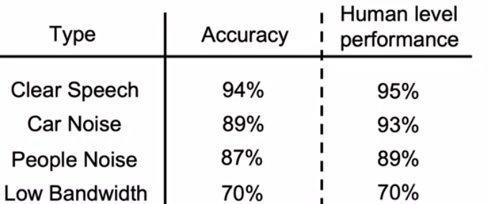
Example on the importance of baselines
Lets remember the speech recognition example.
On the scoping project we have identified 4 categories for speech recognition

Slide 34
Example on the importance of baselines
Lets remember the speech recognition example.
On the scoping project we have identified 4 categories for speech recognition
We develop a ML model and measure the accuracy

Slide 35
Example on the importance of baselines
Lets remember the speech recognition example.
On the scoping project we have identified 4 categories for speech recognition
We develop a ML model and measure the accuracy
We look for ways to improve the overall accuracy of the model!

Slide 36
Example on the importance of baselines
Lets remember the speech recognition example.
On the scoping project we have identified 4 categories for speech recognition
We develop a ML model and measure the accuracy
We look for ways to improve the overall accuracy of the model!
Which category would you focus on?

Slide 37
Example on the importance of baselines
Lets remember the speech recognition example.
On the scoping project we have identified 4 categories for speech recognition
We develop a ML model and measure the accuracy
We look for ways to improve the overall accuracy of the model!
Which category would you focus on?

Slide 38
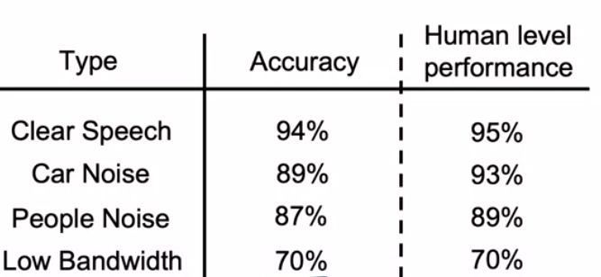
Example on the importance of baselines
Lets remember the speech recognition example.
On the scoping project we have identified 4 categories for speech recognition
We develop a ML model and measure the accuracy
We look for ways to improve the overall accuracy of the model!
We use humans as baselines to understand the predictability
Which category would you focus on?
What do you see?

Slide 39
Example on the importance of baselines
Lets remember the speech recognition example.
On the scoping project we have identified 4 categories for speech recognition
We develop a ML model and measure the accuracy
We look for ways to improve the overall accuracy of the model!
We use humans as baselines to understand the predictability
Potential Improvement
1% Improvement
4% Improvement
2% Improvement
0% Improvement
Which category would you focus on?
What do you see?

Slide 40
Example on the importance of baselines
Lets remember the speech recognition example.
On the scoping project we have identified 4 categories for speech recognition
We develop a ML model and measure the accuracy
We look for ways to improve the overall accuracy of the model!
We use humans as baselines to understand the predictability
Potential Improvement
1% Improvement
4% Improvement
2% Improvement
0% Improvement
Which category would you focus on?
What do you see?
Where do you focus now?

Slide 41
Example on the importance of baselines
Lets remember the speech recognition example.
On the scoping project we have identified 4 categories for speech recognition
We develop a ML model and measure the accuracy
We look for ways to improve the overall accuracy of the model!
We use humans as baselines to understand the predictability
Potential Improvement
1% Improvement
4% Improvement
2% Improvement
0% Improvement
Tip:
Humans are very good at interpreting unstructured data (images, audio)
Thus, they are a very good baseline to start with
(When feasible)
Which category would you focus on?
What do you see?
Where do you focus now?

Slide 42
How to establish a Baseline
Human level performance (mainly on unstructured data and when feasible)
Literature search for state-of-the-art
Quick-and-dirty implementation
Performance of an older system
Baseline helps to indicate what might be possible.
In some cases (such as Human Level Performance) it give a sense on what errors we can fix

Slide 43
How to start modelling?

Slide 44
Never forget!!
Modelling is an iterative loop!!!
Modeling loop

Slide 45
Getting started on modeling
Literature search to see whats possible
courses, blogs, open-source projects)
Find open-source implementations
If someone has done it, try to prove him wrong, otherwise trust him
Remember, a reasonable model with good data often outperforms a good algorithm bad data
Always fix your data first!!

Slide 46
Deployment constraints when picking a model
The question:
Should we take into account deployment constraints when picking a model?

Slide 47
Deployment constraints when picking a model
The question:
Should we take into account deployment constraints when picking a model?
The answer:
Yes: If a baseline is already established and the goal is to build and deploy
No (or not necessarily). If the purpose is to establish a baseline and determine what is possible and might be worth pursuing

Slide 48
Error Analysis

Slide 49
A rule of thumb!
The first time you train a ML algorithm
You can always guarantee that it won't work in the first try (Sorry!)
Focus on how you spend your time after the first failure.

Slide 50
A rule of thumb!
The first time you train a ML algorithm
You can always guarantee that it won't work in the first try (Sorry!)
Focus on how you spend your time after the first failure.
Consider!
Do you blindly improve?
Do you identify the errors and try to fix them?

Slide 51
An example!
We have developed the Speech Recognition model.
We are trying to manually interpret its performance on different examples
We also measure if there is car noise or people noise so we find patterns on the errors

Slide 52
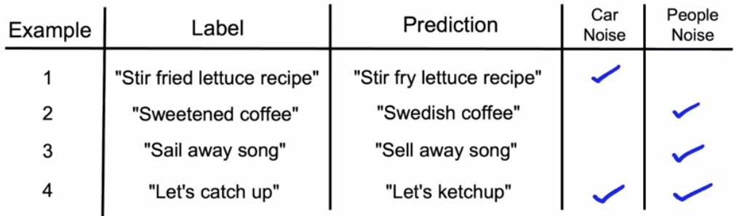
An example!
We have developed the Speech Recognition model.
We are trying to manually interpret its performance on different examples
We also measure if there is car noise or people noise so we find patterns on the errors

Slide 53
An example!
We have developed the Speech Recognition model.
We are trying to manually interpret its performance on different examples
We also measure if there is car noise or people noise so we find patterns on the errors

Slide 54
An example!
We have developed the Speech Recognition model.
We are trying to manually interpret its performance on different examples
We also measure if there is car noise or people noise so we find patterns on the errors

Slide 55
An example!
We have developed the Speech Recognition model.
We are trying to manually interpret its performance on different examples
We also measure if there is car noise or people noise so we find patterns on the errors

Slide 56
An example!
We have developed the Speech Recognition model.
We are trying to manually interpret its performance on different examples
We also measure if there is car noise or people noise so we find patterns on the errors
What do you observe here?

Slide 57
Some useful things to consider
We identified that:
The model struggles with people noise!

Slide 58
Some useful things to consider
We identified that:
The model struggles with people noise!
How to proceed?

Slide 59
Some useful things to consider
We identified that:
The model struggles with people noise!
How to proceed?
Investigate more!!!

Slide 60
Some useful things to consider
We identified that:
The model struggles with people noise!
How to proceed?
Investigate more!!!
What fraction of the errors has that tag?
Of all data with that tag, what fraction is misclassified?
What fraction of all the data has that tag?
How much room for improvement do we have for that tag?

Slide 61
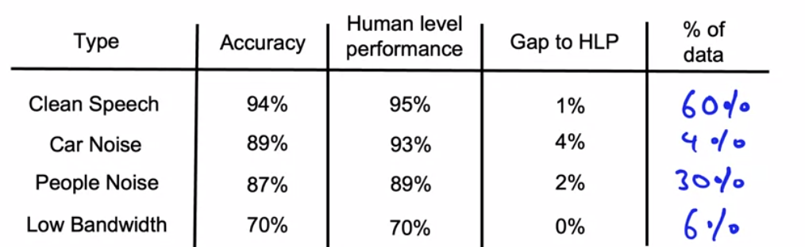
What then?
Prioritizing what to work on!

Slide 62
What then?
Prioritizing what to work on!
For clean speech: If we go from 94% to 95% we will have an overall improvement of 0.6%
For car noise: We get an overall percent of 0.16%
For people noise: We get an 0.6%
For low bandwidth: We get 0% improvement
Where to focus?

Slide 63
What then?
Prioritizing what to work on!
For clean speech: If we go from 94% to 95% we will have an overall improvement of 0.6%
For car noise: We get an overall percent of 0.16%
For people noise: We get an 0.6%
For low bandwidth: We get 0% improvement
Before we said focus on car noise because of the 4% potential room for improvement
But now people noise and clean speech account for 90% of data.
Its worth more going there!!

Slide 64
How to prioritize!
Decide on the most important categories to work on based on:
How much room for improvement there is?
How much frequently that category appears?
How easy it is to improve accuracy on that category?
How important is that category for improvement (medicine example)?

Slide 65
How to improve!
On the categories you have selected!
Collect more data!
Use better feature engineering to improve the data quality
Improve label accuracy quality
Modeling loop

Slide 66
How to handle skewed datasets!

Slide 67
Examples of skewed datasets
Datasets that yield high accuracy simply by returning one class label!
Manufacturing company
99.7 of products have no defect
0.3 of products have a defect
Medical diagnosis
99% of patients do not have a disease
1% do
Speech recognition
A specific word (like “I”) appears almost always

Slide 68
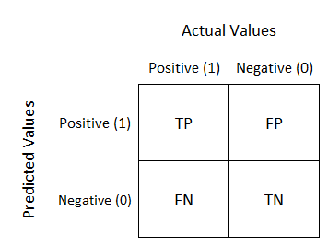
Confusion Matrix
A confusion matrix is a matrix with one axis having the actual labels and the other the predicted

Slide 69
Confusion Matrix
A confusion matrix is a matrix with one axis having the actual labels and the other the predicted

Slide 70
Confusion Matrix
A confusion matrix is a matrix with one axis having the actual labels and the other the predicted
Consider the following skewed example!
914 positive examples (91.4%)
86 negative examples(8.6%)
905
18
9
68

Slide 71
Confusion Matrix
A confusion matrix is a matrix with one axis having the actual labels and the other the predicted
Consider the following skewed example!
914 positive examples (91.4%)
86 negative examples(8.6%)
Is accuracy a good metric here?
905
18
9
68

Slide 72
Confusion Matrix
A confusion matrix is a matrix with one axis having the actual labels and the other the predicted
Consider the following skewed example!
914 positive examples (91.4%)
86 negative examples(8.6%)
Is accuracy a good metric here?
Precision:
Of all predicted positive examples, what fraction where actually positive
Precision = TP/ (TP + FP) = 68/ (68+9) = 88.3
905
18
9
68

Slide 73
Confusion Matrix
A confusion matrix is a matrix with one axis having the actual labels and the other the predicted
Consider the following skewed example!
914 positive examples (91.4%)
86 negative examples(8.6%)
Is accuracy a good metric here?
Precision:
Of all predicted positive examples, what fraction where actually positive
Precision = TP/ (TP + FP) = 68/ (68+9) = 88.3
Recall
Of all actually positive examples, how many did the model get right?
Recall = TP/(TP+FN) = 68/(68+18) = 79%
905
18
9
68

Slide 74
Confusion Matrix
Always Remember:
Precision and recall is much more useful than accuracy on skewed datasets
A confusion matrix is a matrix with one axis having the actual labels and the other the predicted
Consider the following skewed example!
914 positive examples (91.4%)
86 negative examples(8.6%)
Is accuracy a good metric here?
Precision:
Of all predicted positive examples, what fraction where actually positive
Precision = TP/ (TP + FP) = 68/ (68+9) = 88.3
Recall
Of all actually positive examples, how many did the model get right?
Recall = TP/(TP+FN) = 68/(68+18) = 79%
905
18
9
68

Slide 75
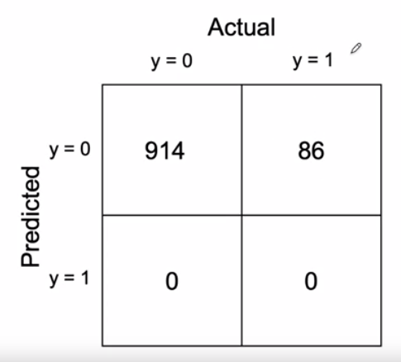
What if I always predict one class
What happens if I always do print(“0”), where 0 is the class with 99% of the data
Precision = TP/(TP+FP) = 0/(0+0) = 0
Recall = TP/(TP+FN) = 0 + (0 + 86) = 0

Slide 76
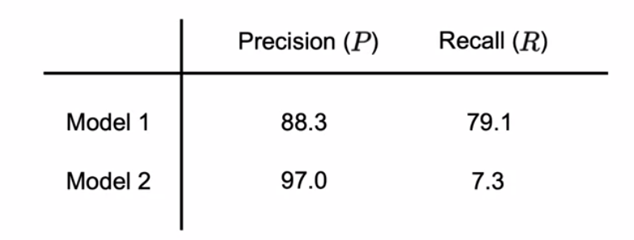
Combine precision and recall
Say I have two models we different Precision and Recall!
How do I pick the best?

Slide 77
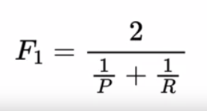
Combine precision and recall
Say I have two models we different Precision and Recall!
How do I pick the best?
To combine Precision and Recall we use F1 score

Slide 78
Combine precision and recall
Say I have two models we different Precision and Recall!
How do I pick the best?
To combine Precision and Recall we use F1 score
Intuition: You want your model to do well on both recall and precision.
F1 score is the harmonic mean of the two!

Slide 79
Combine precision and recall
Say I have two models we different Precision and Recall!
How do I pick the best?
To combine Precision and Recall we use F1 score
Intuition: You want your model to do well on both recall and precision.
F1 score is the harmonic mean of the two!
F1 model 1: 83.4%
F1 model 2: 13.6%

Slide 80
Question on Modelling?

